Slide 1
Lecture 9:
Prof. Dr. Taysir Hassan Abdel Hamid

Slide 2
Outline
Data Control Language (DCL)
Object-oriented Data Modeling
JDBC

Slide 3
Data Control Language (DCL)

Slide 4
Sub-sets of SQL
Data retrieval: SELECT
Data Manipulation Language (DML): INSERT, UPDATE, DELETE
Data Definition Language (DDL): CREATE, ALTER, DROP, RENAME
Data Control Language (DCL): GRANT, REVOKE

Slide 5
Introduction to DB Security
Secrecy: Users shouldn’t be able to see things they are not supposed to.
  E.g., A student can’t see other students’ grades.
Integrity: Users shouldn’t be able to modify things they are not supposed to.
  E.g., Only instructors can assign grades.
Availability: Users should be able to see and modify things they are allowed to.

Slide 6
GRANT Command
GRANT privileges ON object TO users [WITH GRANT OPTION]
The following privileges can be specified:
  SELECT Can read all columns
    including those added later via ALTER TABLE command
  INSERT means same right with respect to all columns.
  DELETE Can delete tuples.
  REFERENCES (column-name) Can define foreign keys (in other tables) that refer to this column.
If you want the recipient(s) to be able to pass the privilege(s) to others add:
WITH GRANT OPTION

Slide 7
Grant Example I
Suppose Joe has created the tables
  Sailors(sid, sname, rating, age)
  Boats(bid, bname, color)
  Reserves(sid, bid, day)
Joe now executes the following:
GRANT INSERT, DELETE ON Reserves
TO Omar
WITH GRANT OPTION;
Omar can now insert or delete Reserves rows and authorize someone else to do the same.

Slide 8
Grant Example II
Joe further executes:
GRANT SELECT ON Reserves TO Michael;
GRANT SELECT ON Sailors TO Michael WITH GRANT OPTION;
Michael can now execute SELECT queries on Sailors and Reserves, and he can pass this privilege to others for Sailors but not for Reserves.

Slide 9
Grant Example II
On the other hand, suppose that Michael creates the following view:
  CREATE VIEW YoungSailors (sid, age, rating) AS
  SELECT S.sid, S.age, S.rating
  FROM Sailors S
  WHERE S.age < 18;
The only underlying table is Sailors, for which Michael has SELECT with grant option. Therefore he can pass this on to Adel and Ahmed:
  GRANT SELECT ON YoungSailors TO Adel,Ahmed;

Slide 10
Grant Example III
Suppose now Joe executes:
GRANT UPDATE (rating) ON Sailors TO Leah;

Slide 11
Role-Based Authorization
Privileges can also be assigned to roles.
Roles can then be granted to users and to other roles.
Reflects how real organizations work.
Example.
CREATE ROLE some_role;
GRANT SELECT ON Reserves TO some_role;
GRANT INSERT ON Sailors TO some_role;
GRANT UPDATE ON Boats TO some_role;
GRANT some_role TO Michael;
GRANT some_role TO Bill;

Slide 12
Revoke Example I
  REVOKE [GRANT OPTION FOR] privileges
  ON object FROM users {RESTRICT | CASCADE}
Suppose Joe is the creator of Sailors.
GRANT SELECT ON Sailors TO Art WITH GRANT OPTION
  (executed by Joe)
GRANT SELECT ON Sailors TO Bob WITH GRANT OPTION
  (executed by Art)
REVOKE SELECT ON Sailors FROM Art CASCADE
  (executed by Joe)

Slide 13
Revoke Example II
Art loses the SELECT privilege on Sailors.
Then Bob, who received this privilege from Art, and only Art, also loses this privilege.
  Bob’s privilege is said to be abandoned
When CASCADE is specified, all abandoned privileges are also revoked
  Possibly causing privileges held by other users to become abandoned and thereby revoked recursively.
If the RESTRICT keyword is specified, the command is rejected if revoking privileges causes other privileges becoming abandoned.

Slide 14
Privilege Descriptors
When a GRANT is executed, a privilege descriptor is added to a table of such descriptors maintained by the DBMS.
The privilege descriptor specifies the:
  grantor of the privilege,
  grantee who receives the privilege,
  granted privilege
  grant option
When a user creates a table or view he 'automatically' gets privileges,
  A privilege descriptor with system as the grantor is entered into the descriptors table.

Slide 15
Object-oriented data modeling

Slide 16
Key Definitions
Object-oriented techniques view a system as a collection of self-contained objects which include both data and processes.
The Unified Modeling Language (UML)
  the object modeling standard
  adds a variety of techniques to the field of system development.

Slide 17
Object Concepts
An object is a person, place, event, or thing about which we want to capture information.
Each object has properties (or attributes).
The state of an object is defined by the value of its properties and relations with other objects at a point in time.
Objects have behaviors -- things that they can do -- which are described by methods (or operations).
Objects do not use primary or foreign keys, instead each instance is assigned a unique identifier (UID) when it is created.

Slide 18
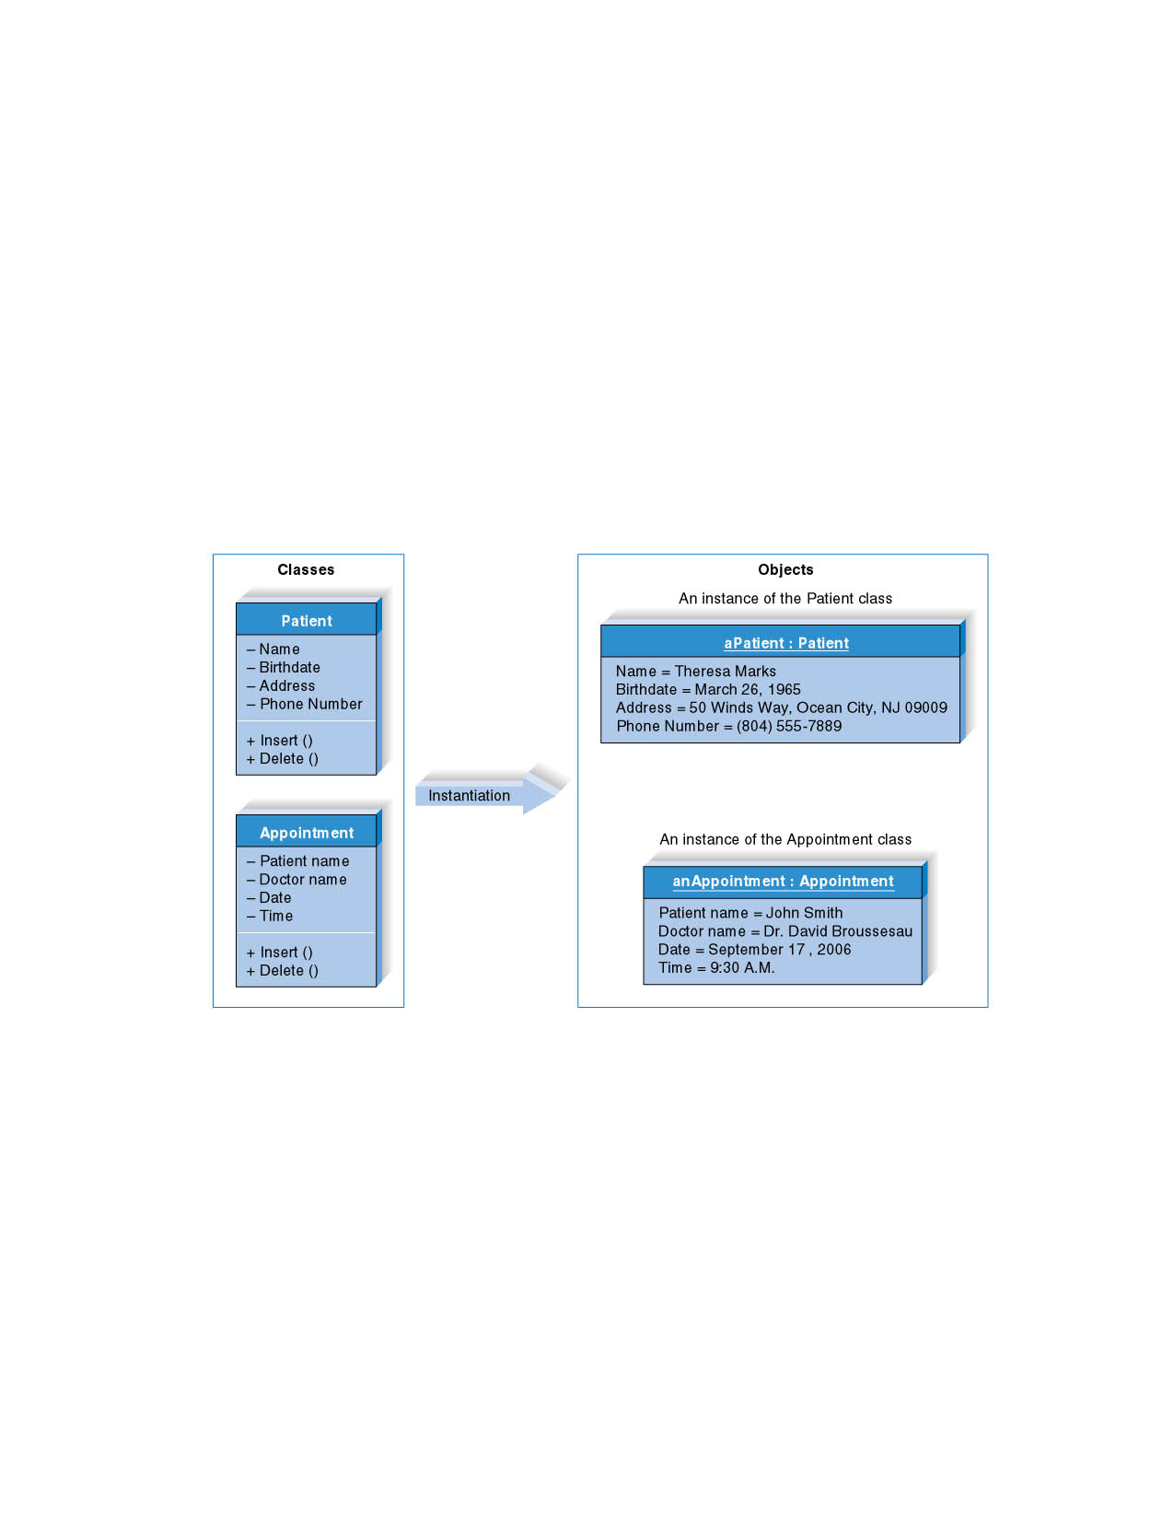
Classes and Objects
15 - <number>

Slide 19
Classes and Objects
A class is a general template we use to define and create specific instances or objects.
An object is an instantiation of a class.
An object is a person, place, event, or thing about which we want to capture information.

Slide 20
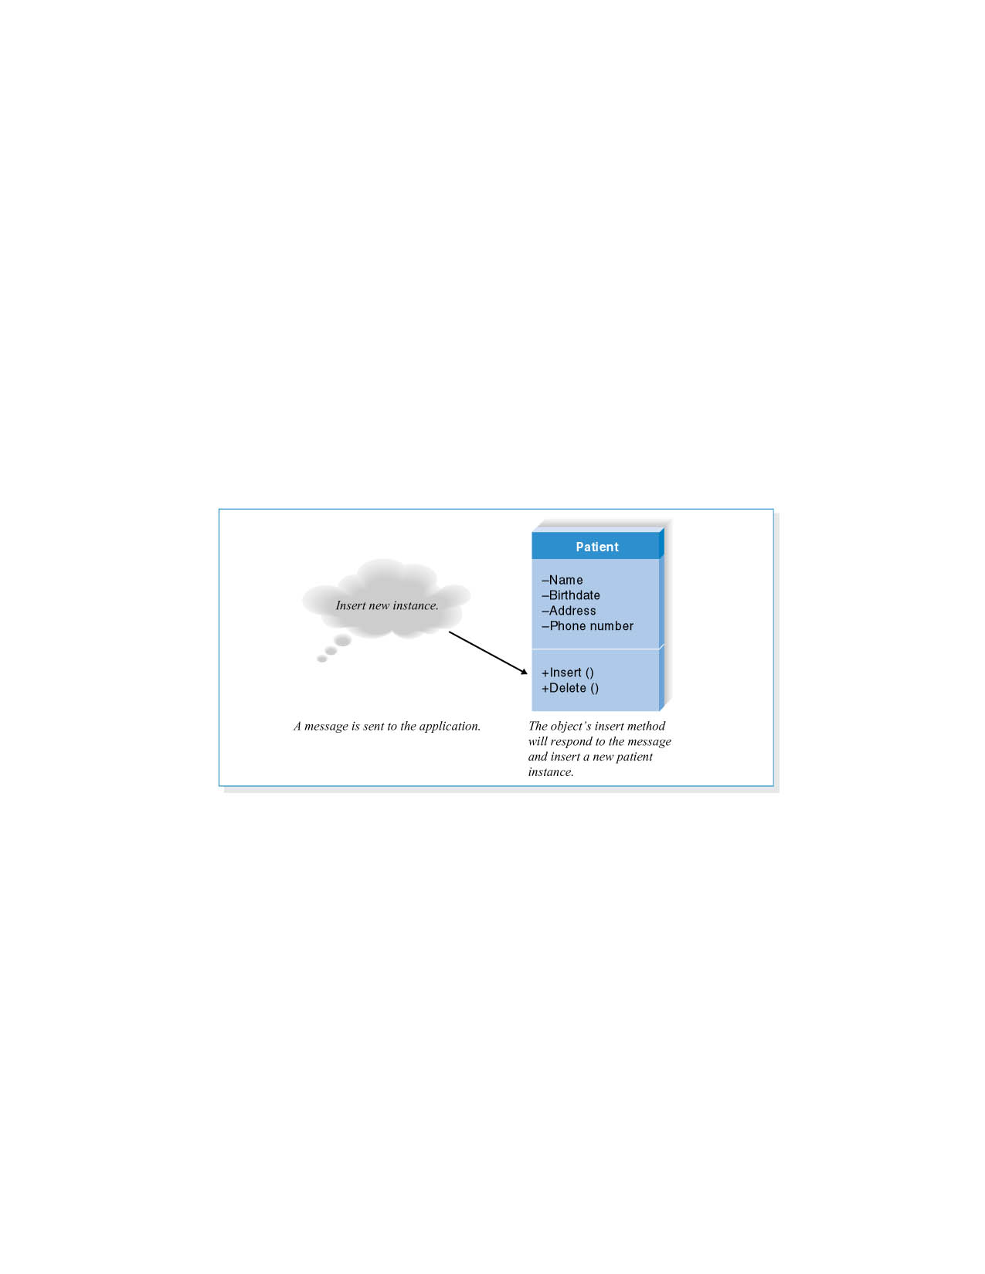
Messages and Methods
Messages are information sent to objects to trigger methods

Slide 21
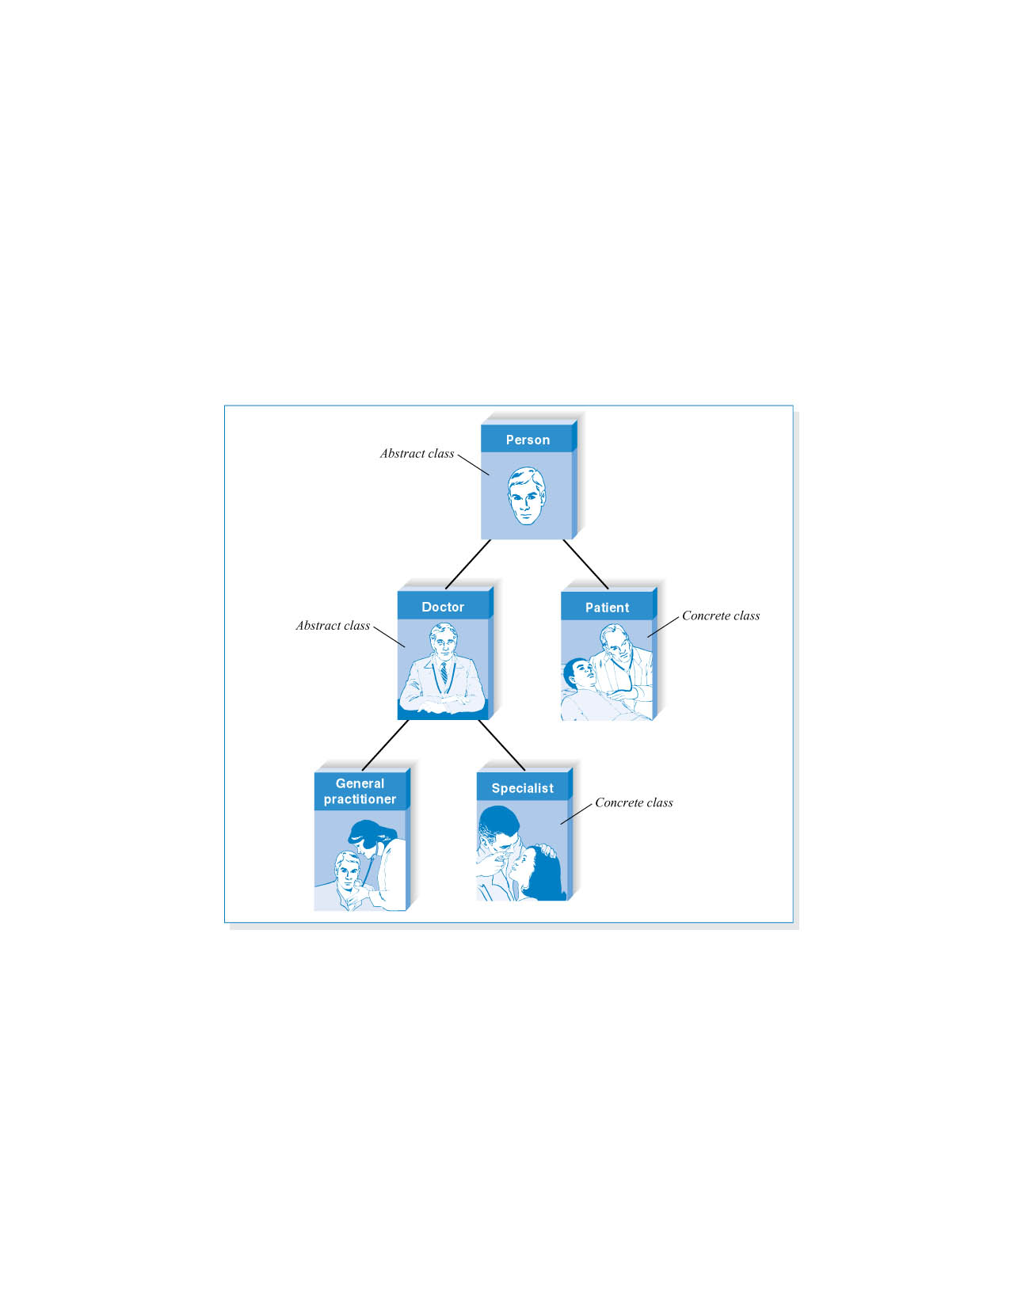
Class Hierarchy

Slide 22
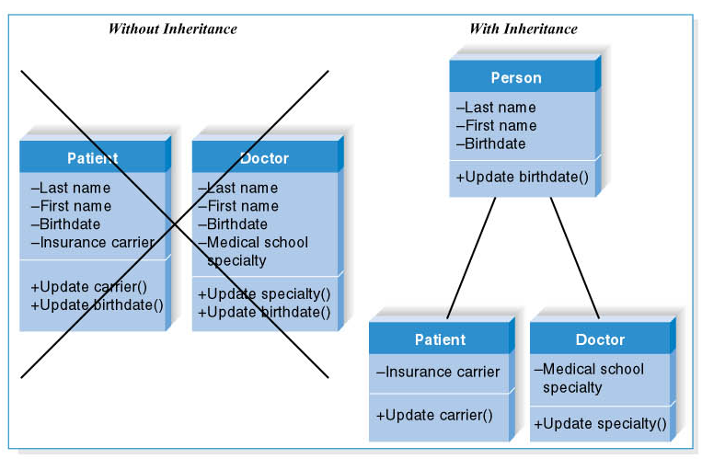
Inheritance

Slide 23
Unified Modeling Language – UML (Version 2)
Defines a set of fourteen object diagramming techniques
The key building block is the use case
Diagrams are tightly integrated syntactically and conceptually to represent an integrated whole
Application of UML can vary among organizations
15 - <number>

Slide 24
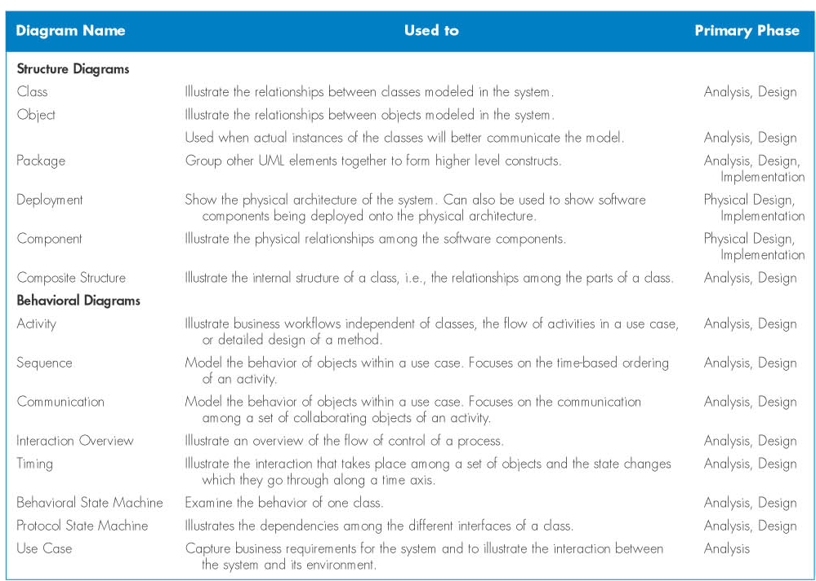
UML 2.0 Diagram Summary

Slide 25
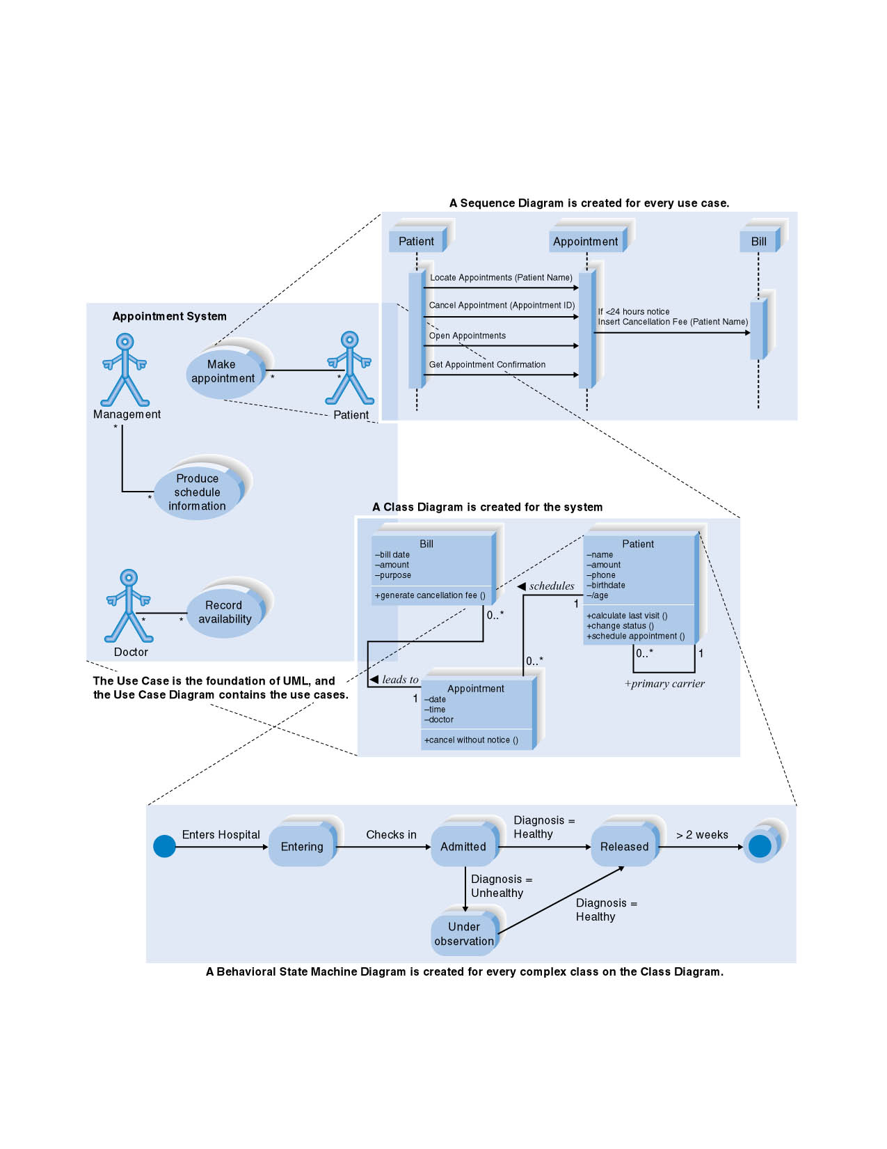
Integration of four UML Diagrams

Slide 26
USE CASE DIAGRAM

Slide 27
Use Case Diagram Concepts
Summarizes all use cases (for the part of the system being modeled) together in one picture
Shows the associations between actors and use cases

Slide 28
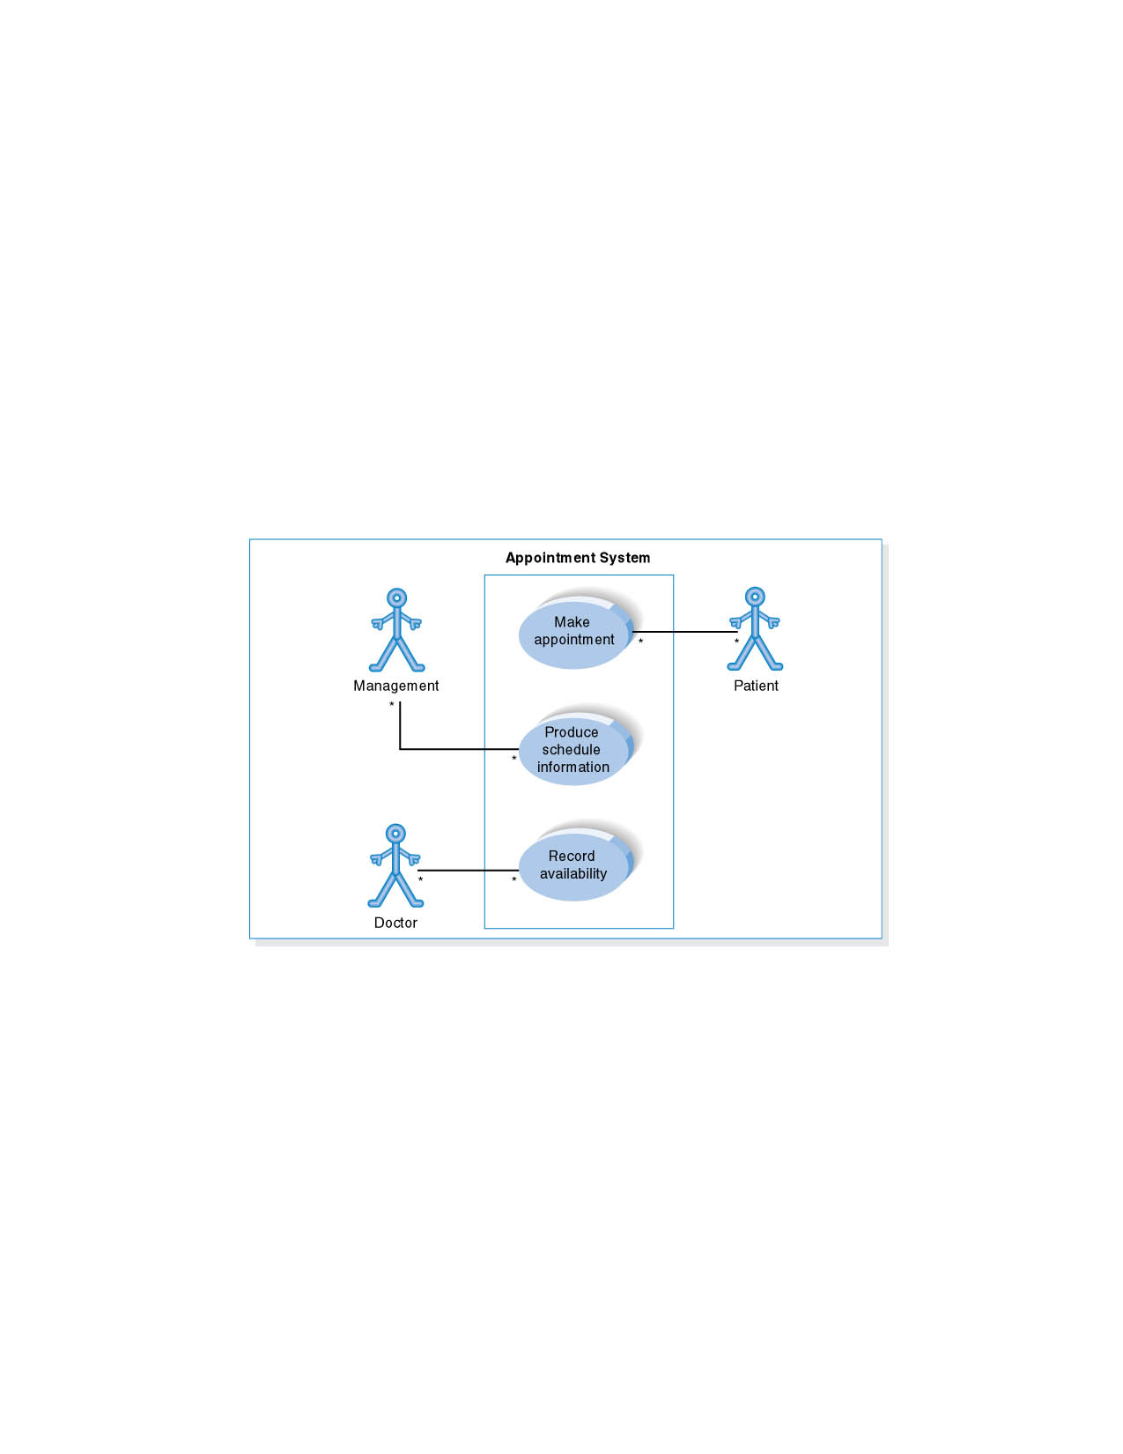
Use Case Diagram for Appointment System

Slide 29
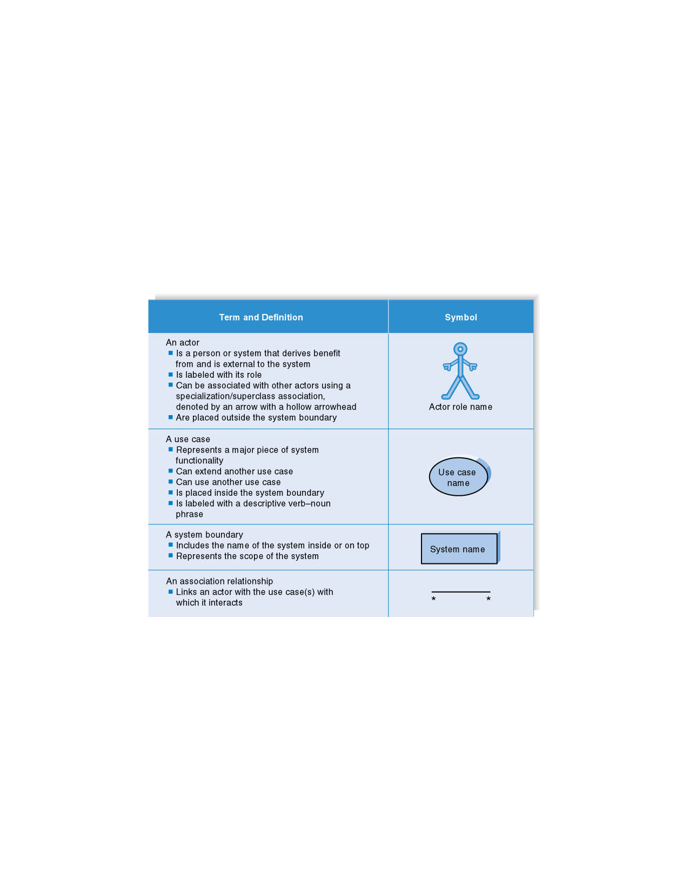
Syntax for Use Case Diagram

Slide 30
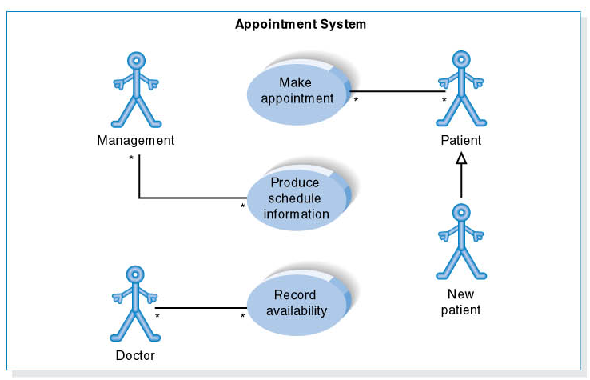
Use Case Diagram for Specialized Actor

Slide 31
Steps in Creating the Use Case Diagram
1. Identify Use Cases
2. Draw the system boundary
3. Place Use Cases on the diagram
4. Identify the actors
5. Add associations

Slide 32
CLASS DIAGRAM

Slide 33
Elements of a Class Diagram
A static model that shows the classes and relationships among classes that remain constant in the system over time
Resembles the ERD, but depicts classes which include both behaviors and states, while entities in the ERD include only attributes
Scope not system wide, but pertaining to a single Use Case

Slide 34
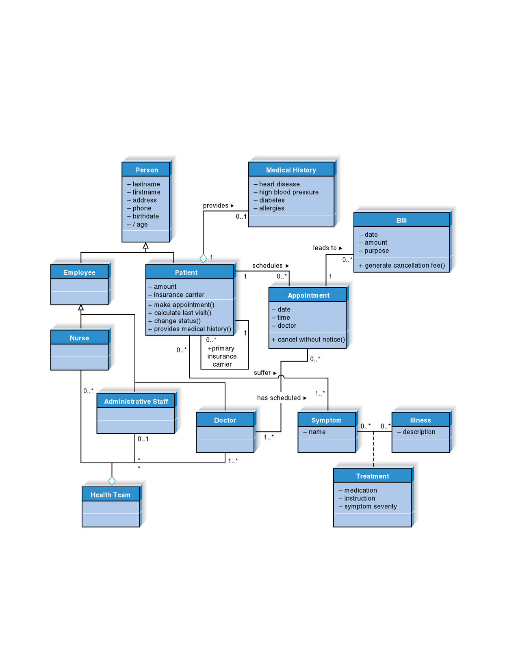
Class Diagram for Manage Appointment
15 - <number>

Slide 35
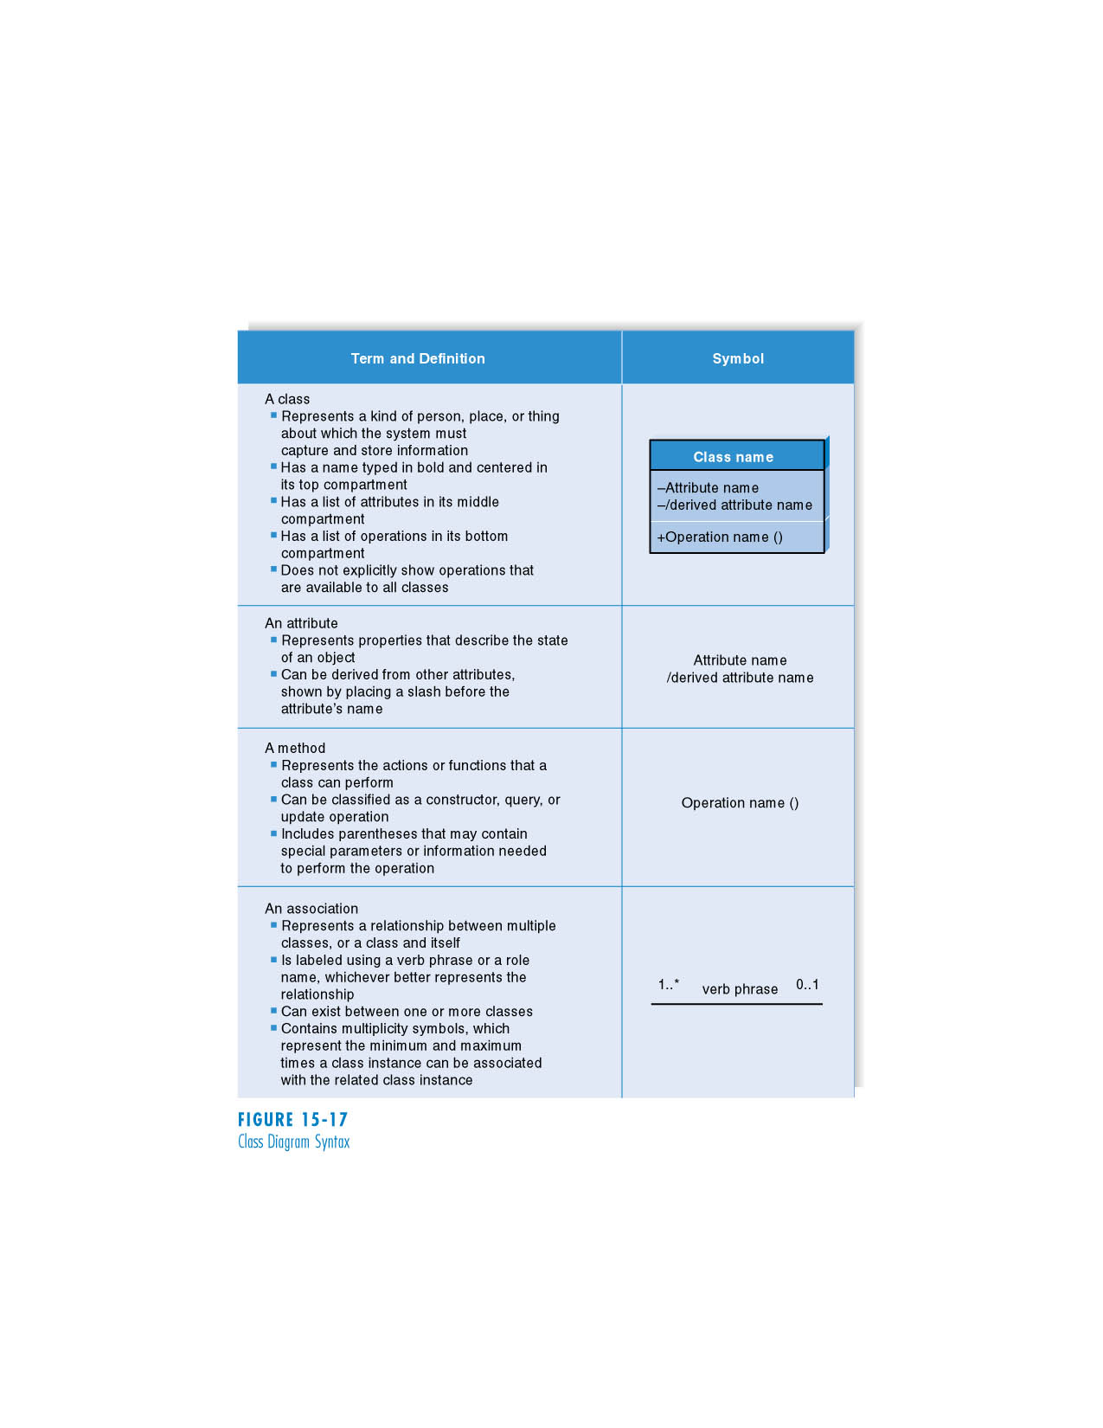
Class Diagram Syntax
15 - <number>

Slide 36
Operation Types
Similar to relationships in ERDs
Multiplicity shows how an instance of an object can be associated with other instances
15 - <number>

Slide 37
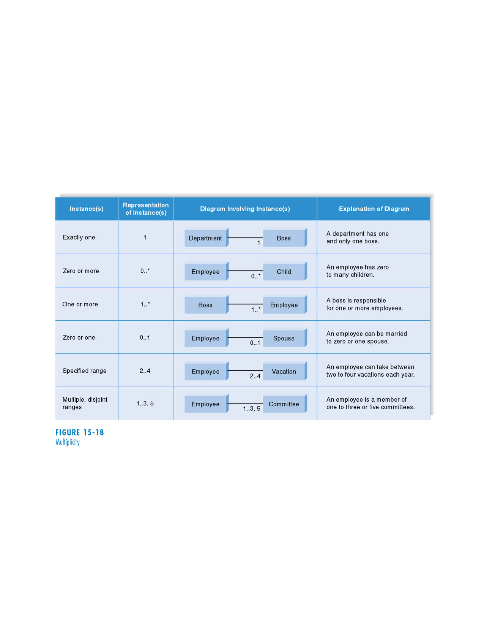
Multiplicity
15 - <number>

Slide 38
Steps in Creating a Class Diagram
1. Identify classes
2. Identify attributes and operations
3. Draw associations between classes
15 - <number>

Slide 39
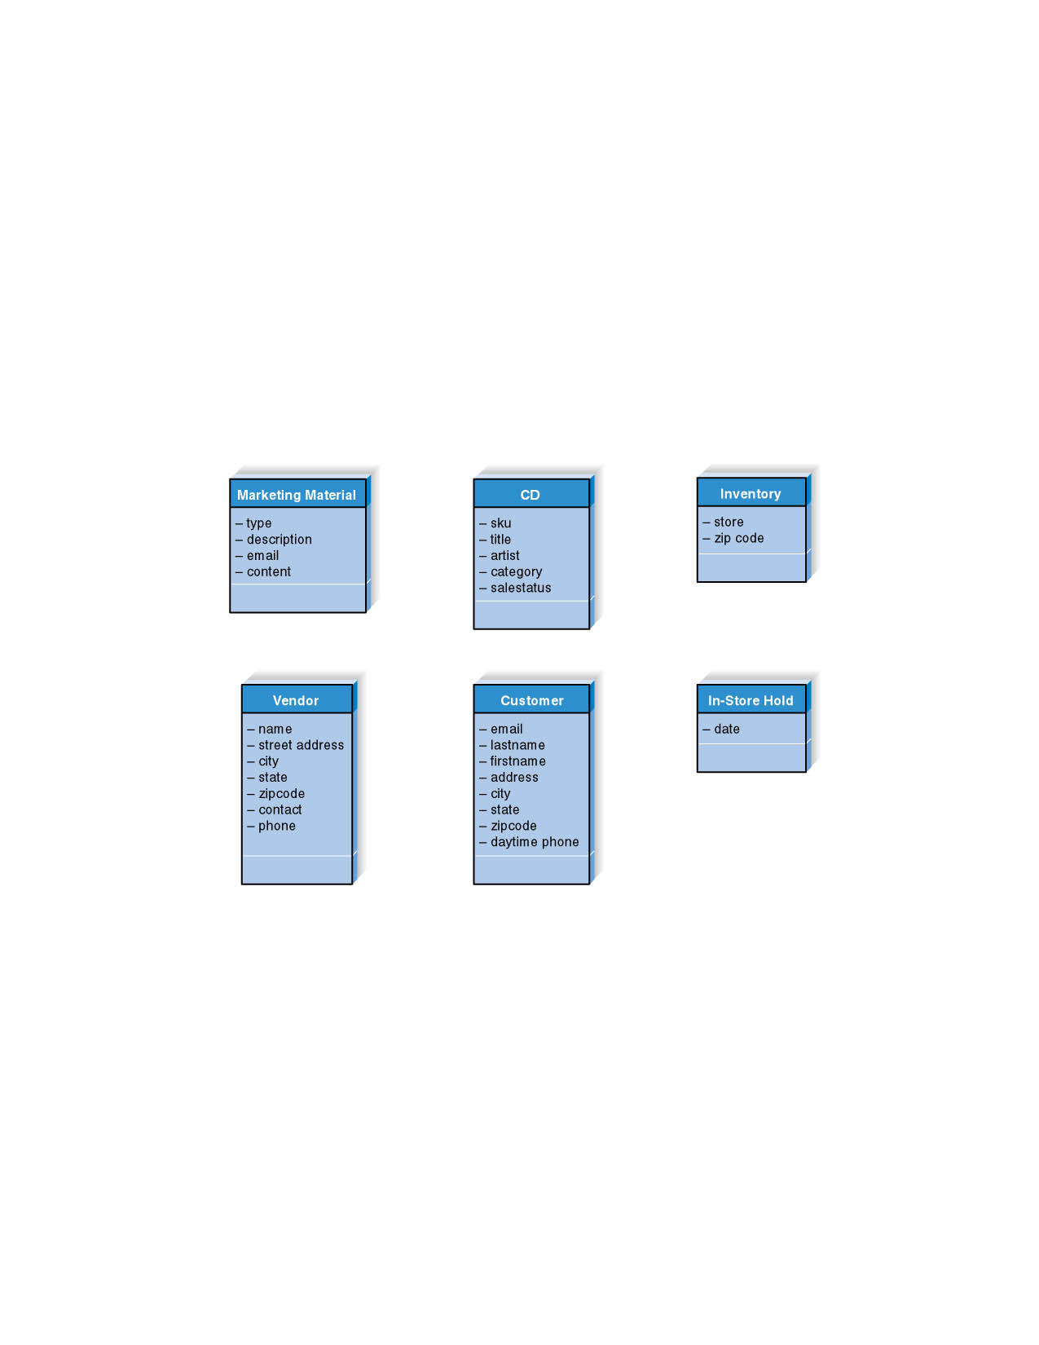
Initial Attributes for Class Diagrams
15 - <number>

Slide 40
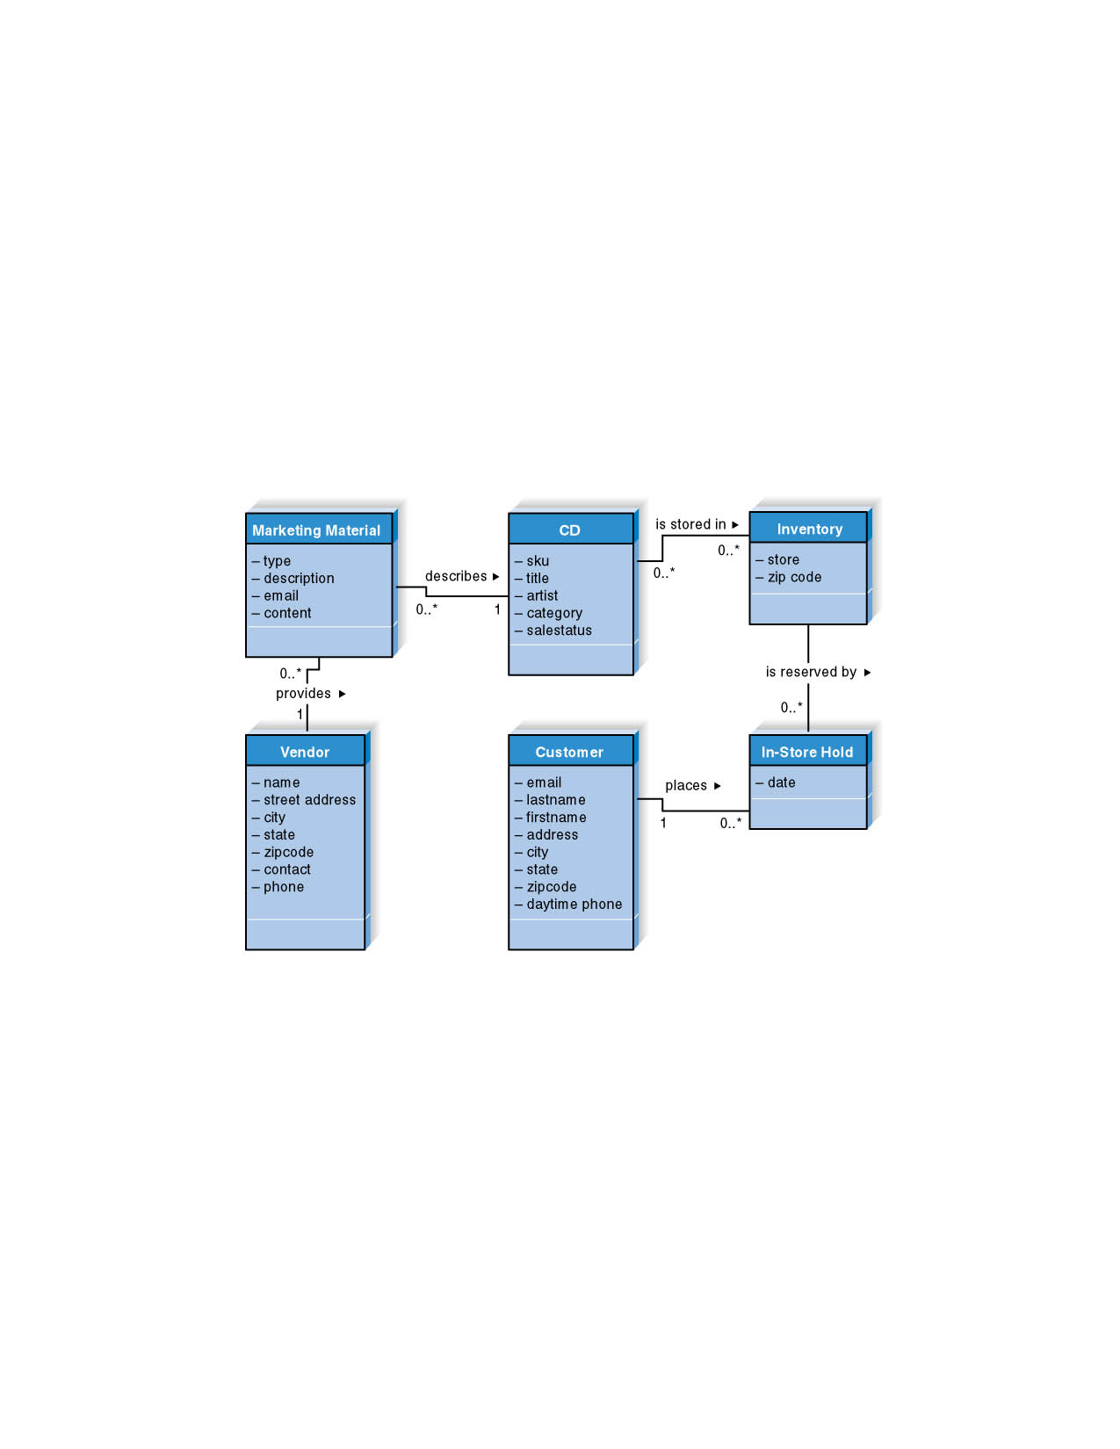
Revised Attributes and Associations
15 - <number>

Slide 41
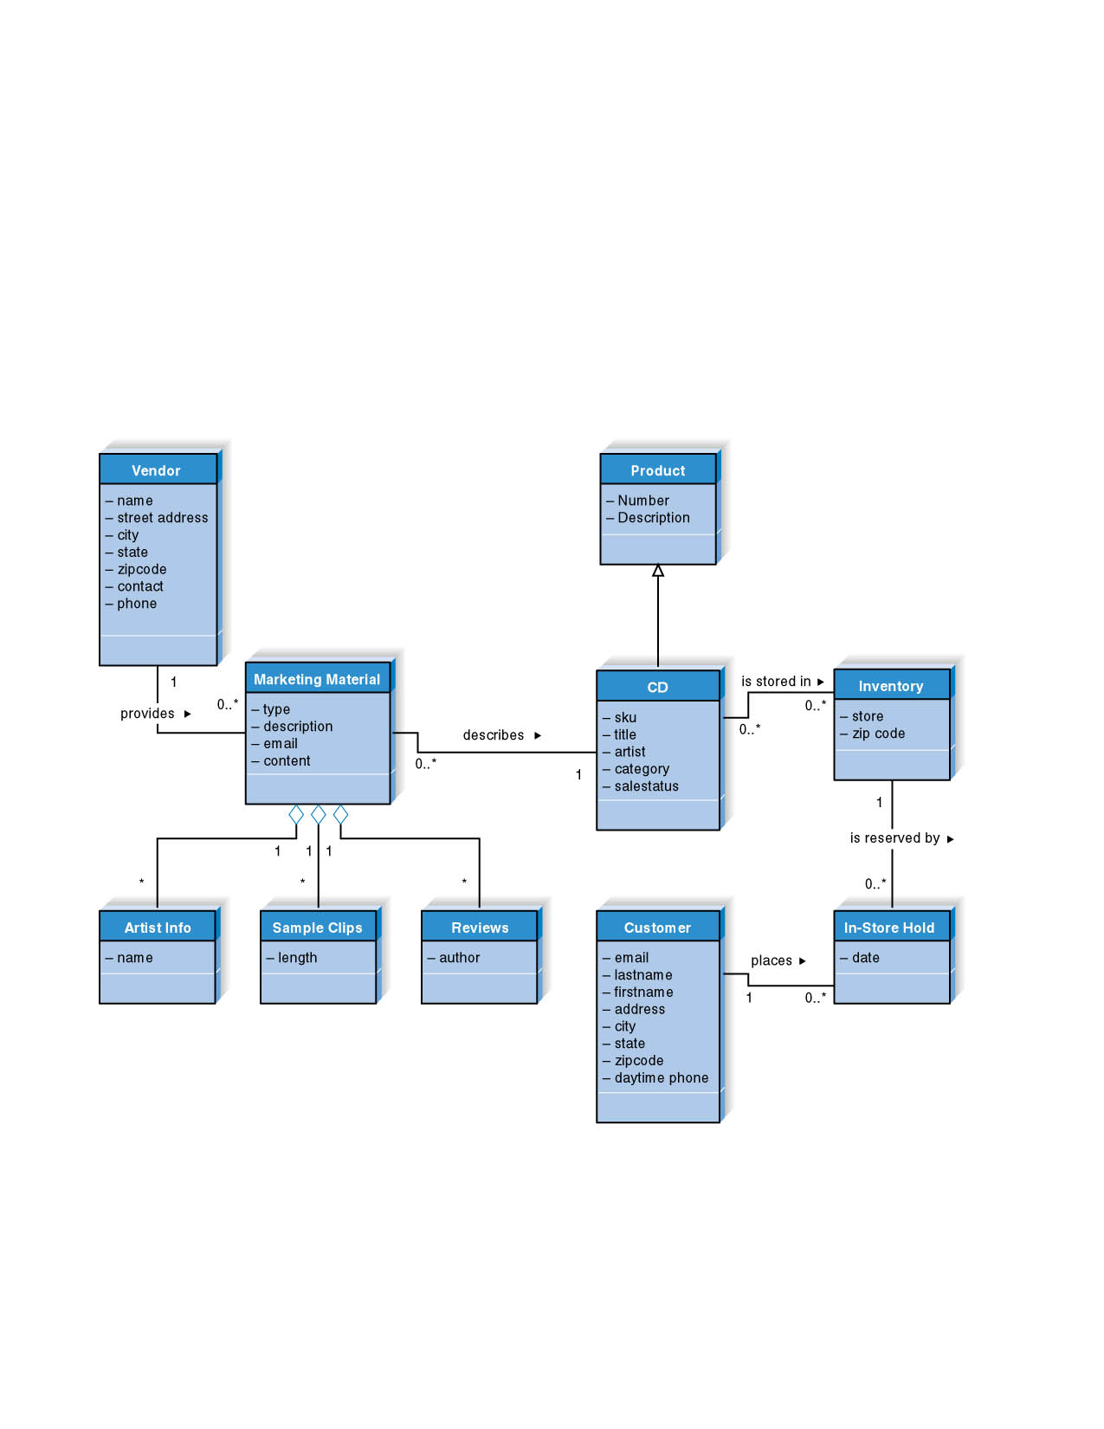
Final Class Diagram
15 - <number>

Slide 42
JDBC
JDBC is an alternative to ODBC and ADO that provides database access to programs written in Java.
JDBC is not an acronym — it doesn’t stand for anything!
JDBC drivers are available for most DBMS products: http://java.sun.com/products/jdbc

Slide 43
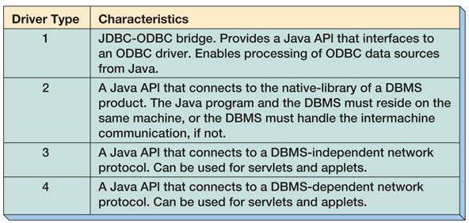
JDBC Driver Types
DAVID M. KROENKE’S DATABASE PROCESSING, 10th Edition
© 2006 Pearson Prentice Hall
14-<number>

Slide 44
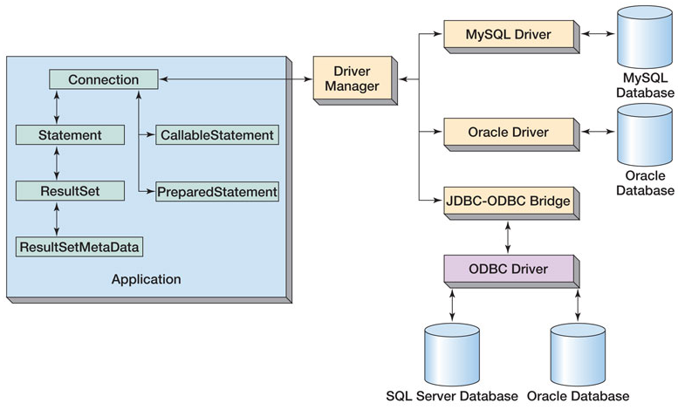
JDBC Components
14-<number>

Slide 45
Using JDBC
1. Load the driver:
  The driver class libraries need to be in the CLASSPATH for the Java compiler and for the Java virtual machine.
  The most reliable way to load the driver into the program is:
  Class.forName(string).newInstance();
2. Establish a connection to the database:
  A connection string includes the literal jdbc:, followed by the name of the driver and a URL to the database.
  Connection conn = DriverManager.getConnection(string);
14-<number>

Slide 46
Using JDBC (Continued)
3. Create a statement:
  Statement stmt = conn.createStatement();
4. Process a the statement:
  Example statements:
  ResultSet rs = stmt.executeQuery(querystring);
  int result = stmt.executeUpdate(updatestring);
  ResultSetMetaData rsMeta = rs.getMetaData();
Both compiled queries and stored procedures can be processed via JDBC using PreparedStatement and CallableStatement objects.
14-<number>

Slide 47
Import java.sql.*;
Public class type_one
{
public static void main (String[] args)
{
try
{ class.forName(“sun.jdbc.odbc.JdbcOdbcDriver”)//load driver
Connection con=DriverManager.getConnection(“jdbc:odbc:HOD_DATA”) //create connection with datasource
Statement s = con.createStatement(); //create statement

Slide 48
String query = “select * from Data”; //create query
S.execute(query);
Resultset rs = s.getResultSet(); //return data from state
While (rs.next() ) //retrieve data from ResultSet
{
System.out.println(“serial number “+rs.getString(1));
System.out.println(“, name “+rs.getString(2));
System.out.println(“ city “+rs.getString(3));
System.out.println(“ and Age “+rs.getString(4));
}
s.close();
con.close();
} catch (Exception e) { System.out.println(“Exception”+e);
} } }

Slide 49


Your final exam
6 questions and you will answer FIVE ONLY
One MCQ
The other five will be: ERD, EER, SQL, Normalization, RA

